Slide 1
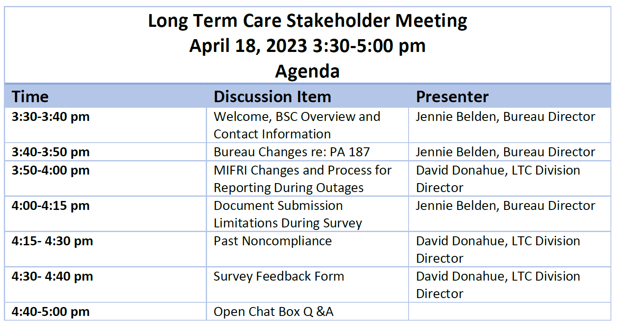

Slide 2



MI-Facility Reported Incidents (MI-FRI)
Major updates to F609 from CMS - QSEP
Process for Reporting During Outages and MI-FRI Changes
MI-FRI outage less than 1 hour
MI-FRI outage greater than 1 hour:
  The MI-FRI state application is not available at this time. Providers should print the MI-FRI screen or message to demonstrate that the state reporting system was unavailable. If the print screen or message does not contain a date or time, the provider should document the date and time to demonstrate attempted compliance with the reporting requirement. The facility is still responsible for submitting the incident into the State of Michigan’s MI-FRI system via MILogin as soon as possible.
Protect People & Promote Business

Slide 3
MI-Facility Reported Incidents (MI-FRI)
All incidents/investigations must be submitted through MI-FRI
Managers can not accept submission via email
  If after submission something needs to be added
Each facility can have up to six active users
  This is in addition to corporate access
Protect People & Promote Business

Slide 4
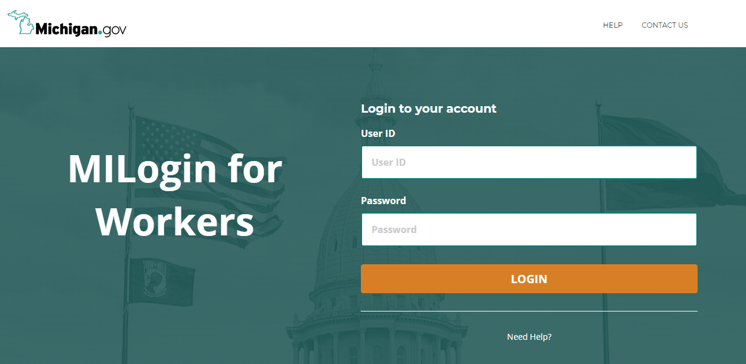
Protect People & Promote Business

Slide 5
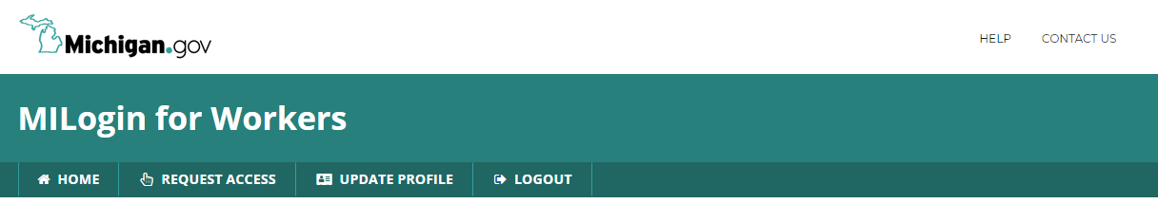
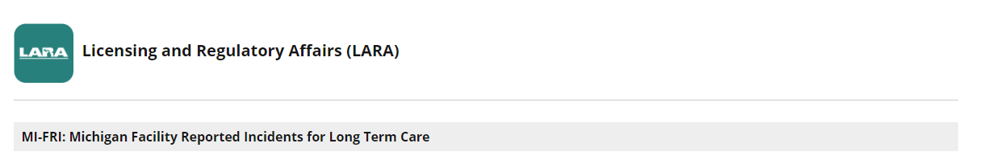
Protect People & Promote Business

Slide 6
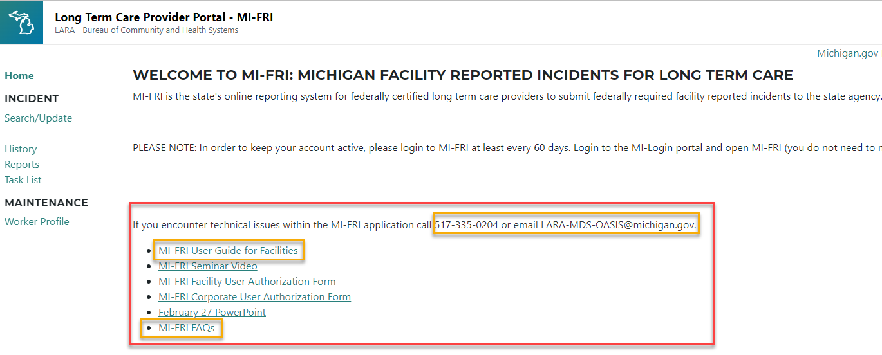
Protect People & Promote Business

Slide 7
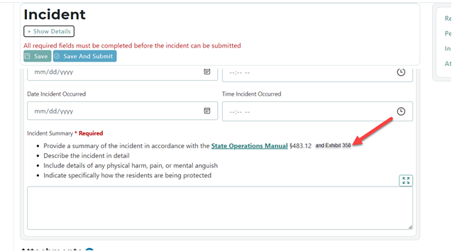
Update to MI-FRI
Protect People & Promote Business

Slide 8
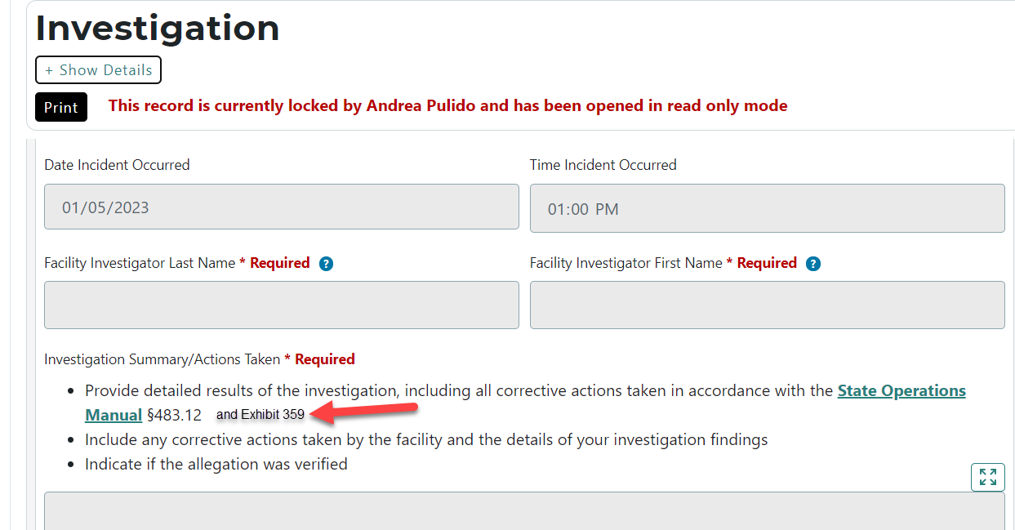
Update to MI-FRI
Protect People & Promote Business

Slide 9
Facility Reported Incidents (FRI)
EXHIBIT 358 Sample Form for Facility Reported Incidents
EXHIBIT 359 Follow-up Investigation Report
Protect People & Promote Business

Slide 10
Documents during survey
All surveys should be completely paperless
Have your EHR Information sheet update and available upon entrance
Protect People & Promote Business

Slide 11
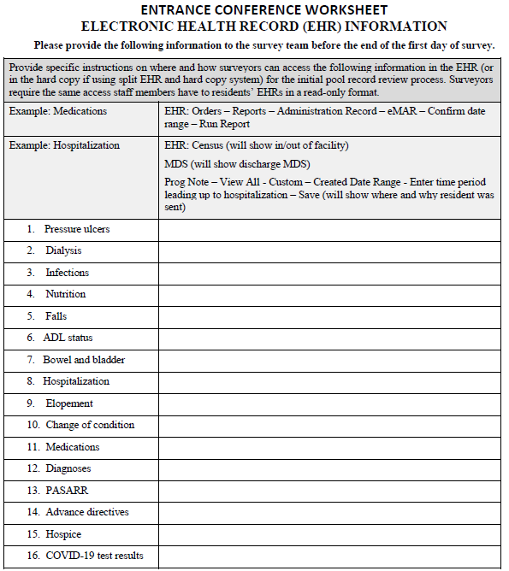
Protect People & Promote Business

Slide 12
Documents during survey
All surveys should be completely paperless
Have your EHR Information sheet update and available upon entrance
BSC is researching other means to collect documents
SOM email limited to 25mb – this includes attachments and the email itself
Other observations?
Protect People & Promote Business

Slide 13
Past Noncompliance (PNC)
What is Past Noncompliance?
  Past noncompliance may be identified during any survey
  The survey team is expected to follow the investigative protocols and surveyor guidance
  To cite past noncompliance with a specific survey data tag, all criteria must be met:
    1. The facility was not in compliance at the time the situation occurred;
    2. The noncompliance occurred after the exit date of the last standard and before the current survey; and
    3. There is sufficient evidence that the facility corrected the noncompliance and is in substantial compliance at the time of the current survey; has the facility ran through the POC and QAPI process
Protect People & Promote Business

Slide 14
Past Noncompliance (PNC)
A nursing home does not provide a plan of correction
Past noncompliance may be cited on any type of survey
Data about past noncompliance tags are not carried forward to subsequent revisit surveys.
Past noncompliance is documented at the actual deficiency tag
A scope and severity determination is assigned to a past noncompliance citation
Surveyors document on the CMS-2567 the nursing home’s actions to correct the past noncompliance
Surveyors use an in-house tool to assist them
Protect People & Promote Business

