Slide 1
MDHHS Nursing Facility
Reimbursement
Webinar
February 2025

Slide 2

Welcome and Meeting Objectives
Serve as an opportunity for continued open and transparent communication between the department and industry.
Provide updates on Nursing Facility Cost Report Preparation and various other LTC Reimbursement and Audit items.

Slide 3
    Housekeeping Items
    Because of the large numbers of registered participants, we will be muting all participants except for the presenters to minimize distractions.

Slide 4
Housekeeping Items
    If your question is for a “Provider Specific” scenario that is only relevant to you, we ask that you submit it to the DARS@ Michigan.gov mailbox & we will answer it there.
    Finally, we are recording this presentation & we will share the link once it is available.

Slide 5
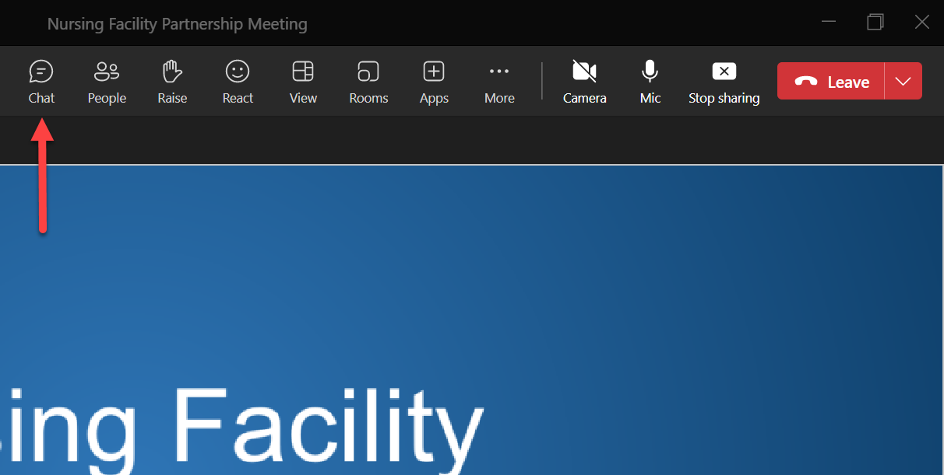

    How to Ask Questions During the Presentation
We will be taking general questions during the presentation. To submit a question, please follow the below steps:
Step 1:
Please click on the icon in the top of your screen as shown to the right.

Slide 6

    How to Ask Questions During the Presentation
Step 2:
Upon clicking on , a pane will show up on the right side of the screen to type in and submit questions in the bottom right-hand corner.
Please type in your question at the bottom of the pane and hit “enter”.

Slide 7
    How to Ask Questions During the Presentation
Step 3:
Once you hit “enter”, your question will appear in the pane
Our team will be able to see your submitted question and we intend to address all submitted questions in writing after the presentation.

Slide 8
Re-Organization

Slide 9
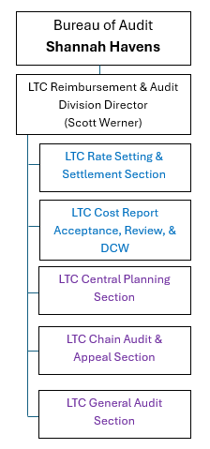
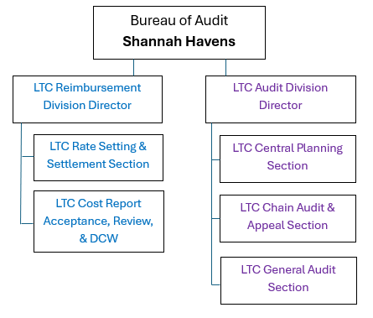
Re-Organization
Previous:
New:
Reimbursement Division responsible for cost report acceptance, rate setting, settlements, etc.
Audit Division responsible for all cost report audits
Director positions posted 2/18/25

Slide 10

Agenda
Overview of important requirements for preparing the FY24 Cost Report
Special Reporting Considerations
Cost Report Errors/Return trends from the past year
Cost Report Audit Process Reporting
What’s Next
Questions

Slide 11

    Cost Report Overview
    A nursing facility participating in the Medicaid program must submit an annual Medicaid Cost Report to MDHHS as a condition of participation.
    Information reported must conform to the requirements set forth in the Provider Reimbursement Manual, Medicaid State Plan, Medicaid Provider Manual, Program Bulletins and Cost Report Instructions.

Slide 12
    Cost Report Overview
    Michigan’s Nursing Facility Medicaid Cost Report is comprised of 31 different worksheets including:
Worksheet Title | Worksheet Number
Information and Certification | WSA
Statistical and Fiscal Data | WSB
Ownership Information and Questionnaire | WSC
Mapping of Provider General Ledger to Cost Report | WSD
Statement of Revenue and Expenses | WS1
General Reclassifications | WS1-A
Adjustments to Expenses | WS1-B
Statement of Costs of Services from Related Organizations | WS1-C
Statement of Leased Capital Assets | WS1-D
Statement of Salaries and Wages | WS1-E
Notes:
Brad presents

Slide 13
    Cost Report Overview
Worksheet Title | Worksheet Number
Salary Information of Owners, Officers, Administrators and Department Heads | WS1-E-1
Salary Information of Owners, Administrators, Assistant Administrators and Relatives | WS1-F
Employee Health & Welfare B/S Reclassifications | WS1-G
Cost Allocation – Statistical Basis | WS2
Cost Allocation – General Service Costs | WS2-A
Cost Allocation – General Service Costs excluding Depreciation | WS2-B
Computation of Inpatient Base Costs | WS2-C
Computation of Inpatient Base Costs excluding Depreciation | WS2-D
Computation of Plant Cost | WS2-E
Computation of Plant Cost excluding Depreciation | WS2-F
Notes:
Brad presents

Slide 14
    Cost Report Overview
Worksheet Title | Worksheet Number
Determination of Support Costs, Per Patient Day Costs, and Support/Base Cost Ratio | WS2-G
Determination of Support Costs, Per Patient Day Costs, and Support/Base Cost Ratio excluding Depreciation | WS2-H
Statement of Capital Asset Values | WS3
Statement of Capital Asset Values – Lessor | WS3-LESSOR
Statement of Directly Identified Asset Values | WS3-A
Allocation of Capital Asset Values & Determination of Relative Percentages | WS3-B
Apportionment of Ancillary Services to Health Care Programs | WS4
Balance Sheet | WS5
Determination of Average Borrowings Balance | WS6
Wage Cost Reporting Summary | WS7
Nurse Aide Training and Testing Program | WS8
Notes:
Brad presents

Slide 15

    Acceptable Cost Report Requirements
    Standardized Electronic Cost Report data in accordance with specified formatting and software.
    Signed Certification Statement (Worksheet A) by an authorized representative of your nursing facility.
    A copy of the nursing facility's detailed general ledger including invoice number and expense description (no grouping or summary) & complete trial balance of revenues & expenses. (EXCEL)
    Supporting documentation for Worksheet 1-A & Worksheet 1-B

Slide 16
    Acceptable Cost Report Requirements
    A completed cost report submission checklist including:
    File transfer electronic cost report text file.
    File transfer copy of Worksheet A, signed by facility representative. The Worksheet A must agree with submitted electronic cost report file.
    Facility’s Detail General Ledger (not a grouping or summary sheet). NOTE: submission of the Detail General Ledger as an electronic file (EXCEL software) is preferred.
    Facility’s Trial Balance (not a grouping or summary sheet) and a crosswalk to Worksheet 1 of the cost report.
    Worksheet B, when the calculation of inpatient days is not the number of routine care beds on the first day of the cost reporting period times the number of days in the cost reporting period, the inpatient day calculation is being provided. NOTE: submission of the calculation as an electronic file (in WORD or EXCEL software) is preferred.
    Worksheet 2, explanation of any changes in statistics (in either the total or individual cost centers) from prior year. Changes in the statistical basis from prior reporting periods requires prior approval from the Department.

Slide 17
    Acceptable Cost Report Requirements
    A completed cost report submission checklist including:
    Worksheet 3 and/or Worksheet 3 – Lessor, explanation of differences between the prior periods ending asset cost balance and the current period’s beginning asset cost balance, when a change in ownership has not occurred. An asset balances carry forward schedule.
    Copy of facility’s financial statements, when not completing Worksheet 5 (applicable to Medical Care Facilities and Hospital Long Term Care Units only).
    Worksheet 6, explanation of differences between the prior period’s loan(s) ending balance and the current period’s beginning loan(s) balance, when a change in ownership has not occurred.
    Michigan Electronic Home Office Statement (form MSA 1578), if applicable
    Management Services – if not supported by Home Office Cost Report, documentation which includes the name of the management services organization and the monthly management charges should be submitted.
    Time Study documentation for position(s) that split time between cost centers, if applicable.
    Explanations for validation warnings, if applicable.

Slide 18
Special Reporting Considerations

Slide 19

    Provider Relief Funds (PRF)
  Federal awards used to prevent, prepare for, and respond to coronavirus for necessary health care related expenses or lost revenues that are attributable to coronavirus.
  Considerations for PRF Funds:
  Payer of last resort: First apply all amounts received from other sources toward covering health care-related expenses.
  After all other funding sources (received or obligated to be received) are depleted, PRF funds can be used to cover the remaining health care-related expenses.

Slide 20
    Provider Relief Funds
Cost Reporting Guidance:
Expenses: Providers must remove reported costs which were also identified as PRF funded health care related expenses with a Worksheet 1-B adjustment on the cost report. This removal of recovered costs is consistent with our traditional Cost Reporting approach, CMS 15-1 Section 2328.C, and the guidance outlined in CMS 15-2 Section 3012 as mandated by the CARES ACT Provider Relief Fund Frequently Asked Questions.
If PRF funds were used to cover lost revenues, then no Worksheet 1-B adjustment is required. PRF funds can only be used to cover lost revenues up to June 30, 2023, the end of the quarter in which the COVID-19 Public Health Emergency ended.
Revenues: Please report all Provider Relief Fund revenues on WS1 – Line 72 (Grants, Endowments and Trusts) of the cost report.

Slide 21
    Provider Relief Funds
Supporting Documentation Required:
For revenues reported on WS1 – Line 72, we will require a supporting workpaper that shows a breakdown of the different funding sources.
Additional supporting documentation including (but not limited to) the Health Resources & Services Administration PRF Financial Summaries, applicable Single Audit and/or HRSA audit conclusions may be requested for review at the time of the MDHHS Cost Report audit to help support the PRF funded revenues, expenses and “lost revenues” reported. PRF recipients may use payments for "lost revenues", but only up to June 30, 2023, the end of the quarter in which the COVID-19 Public Health Emergency ended.

Slide 22

Direct Care Wage Increase
The direct care workers and non-clinical staff serving on the frontlines ensure the health, safety, and well-being to our most vulnerable. In recognition of the critical care these workers provide in long-term care settings, MDHHS continued (and expanded) the direct care wage increase program to SNF direct care workers and non-clinical staff.
For eligible direct care workers, the hourly wage increase is $2.35 through September 30, 2023, and $3.20 for time periods occurring October 1, 2023 through September 30, 2024 (FY24).
For eligible non-clinical workers, the hour wage increase is $.85 for time periods occurring October 1, 2023, through September 30, 2024 (FY24).

Slide 23
Direct Care Wage Increase
Cost Reporting Guidance:
Expenses: “Direct Care Wage Increase” expenses (wages and payroll tax expense) should be reported on the appropriate SNF Provider DCW Pass-Through Reimbursement Form.
Providers must then offset all “Direct Care Wage Increase” expenses with a Worksheet 1-B adjustment on the cost report.
Revenues: Please report all “Direct Care Wage Increase” revenues received from the State of Michigan on WS1 – Line 72. For revenues reported on WS1 – Line 72, we will require a supporting workpaper that shows a breakdown of the different funding sources.

Slide 24

Nursing Home Support Payments
  PA 87 of 2021 appropriated funding for long-term care facility support to address the economic impact of the COVID-19 public health emergency on nursing home providers in State FY21.
  PA 67 of 2021 appropriated funding for long-term facility support to provide a $23 per Medicaid day increase to nursing facilities that have experienced a 5% or greater decline in average daily census in State FY21.

Slide 25
Nursing Home Support Payments
Cost Reporting Guidance:
Expenses: Providers must offset all “Long Term Care Facility Support Payment” expenses with a Worksheet 1-B adjustment on the cost report.
Please note:
If these support payments were previously fully expended in a prior reporting period and fully offset as a 1-B adjustment, no expenses would need to be reported this period.
If these payments were not fully expended in prior periods, a supporting spreadsheet must be provided to support the 1-B adjustment amount. This spreadsheet must detail the items purchased and the total amount spent to date.
If Public Act 67 or 87 funds were used to cover lost revenues, then no Worksheet 1-B adjustment is required. Documentation will be requested during the Cost Report audit to support the lost revenue calculation.

Slide 26
Nursing Home Support Payments
Cost Reporting Guidance:
Revenues: Please report all “Long Term Care Facility Support Payment” revenues received from the State of Michigan on WS1 – Line 72.
For revenues reported on WS1 – Line 72, we will require a supporting workpaper that shows a breakdown of the different funding sources.
Note: Most facilities received PA 67 & 87 Grant revenue prior to 2022 and would not be required to report any revenue this period.

Slide 27

Civil Money Penalty Reinvestment
A Civil Money Penalty (CMP) is a monetary penalty the Centers for Medicare & Medicaid Services (CMS) may impose against nursing homes for substantial noncompliance with one or more Medicare and Medicaid participation requirements for long-term care facilities.
A portion of CMPs collected from nursing homes are returned to the state to be reinvested in support activities that benefit nursing home residents and that protect or improve their quality of care or quality of life.

Slide 28
Civil Money Penalty Reinvestment
Cost Reporting Guidance:
Expenses: Providers must offset all “Civil Money Penalty Reinvestment Program” expenses with a Worksheet 1-B adjustment on the cost report.
Revenues: Please report all “Civil Money Penalty Reinvestment Program” revenues received from the State of Michigan on WS1 – Line 72.
For revenues reported on WS1 – Line 72, we will require a supporting workpaper that shows a breakdown of the different funding sources.

Slide 29

Paycheck Protection Program (PPP) Loans
The Paycheck Protection Program was a loan designed to provide a direct incentive for small businesses to keep their workers on the payroll. The Paycheck Protection Program (PPP) ended on May 31, 2021. Borrowers can apply for forgiveness any time for up to five years from the date that SBA issued the SBA loan number. SBA will forgive loans if all employee retention criteria are met, and the funds are used for eligible expenses.

Slide 30
Paycheck Protection Program (PPP) Loans
Cost Reporting Guidance:
If criteria is met to forgive all or part of the loan, please report the following:
Expenses: Providers must not offset expenses covered by a forgiven PPP loan in accordance with the COVID-19 Frequently Asked Questions (FAQs) on Medicare Fee-for-Service (FFS) Billing, Section V. Cost Reporting from CMS.
Revenues: Please report funds received from the forgiven PPP loan on WS1 – Line 72.
For revenues are reported on WS1 – Line 72, we will require a supporting workpaper that shows a breakdown of the different funding sources and the loan forgiveness documentation from the U.S. Small Business Administration.

Slide 31
Paycheck Protection Program (PPP) Loans
Cost Reporting Guidance:
If criteria is not met to forgive all or part of the loan, please utilize the Worksheet 6 guidance within our cost report instructions for the reporting of the loan balance and report the related interest expense like other interest expenses on the cost report.
Please note that these COVID-19 pandemic working capital loans will not be subjected to the 12 month or less requirement.

Slide 32

State & Local Fiscal Recovery Fund
The State Fiscal Recovery Fund and Coronavirus Local Fiscal Recovery Fund, which together make up the Coronavirus State and Local Fiscal Recovery Funds (“SLFRF”) program. This program is intended to provide support to State, territorial, local, and Tribal governments in responding to the economic and public health impacts of COVID-19 and in their efforts to contain impacts on their communities, residents, and businesses.

Slide 33
State & Local Fiscal Recovery Fund
Cost Reporting Guidance:
Expenses: Providers must offset SLFRF funded expenses with a Worksheet 1-B adjustment on the cost report. If SLFRF funds were used to cover lost revenues, then no Worksheet 1-B adjustment is required. Documentation will be requested during audit to support the lost revenue calculation. Funds must be spent on eligible/allowable costs as dictated by the State and Local Fiscal Recovery Funds Compliance and Reporting Guidance. Facilities are also subject to the requirements of 2 CFR 200. The SLFRF Guidance also states that facilities may use SLFRF funds to cover eligible costs incurred during the period beginning March 3, 2021 and ending December 31, 2024, as long as the award funds for the obligations incurred by December 31, 2024 are expended by December 31, 2026.
Revenues: Please report all SLFRF revenues on WS1 – Line 72 of the cost report. For revenues reported on WS1 – Line 72, we will require a supporting workpaper that shows a breakdown of the different funding sources.

Slide 34

Other Federal, State or Local Funding
MDHHS recognizes that providers may have received other Federal, State or Local funding to support your operations beyond what is noted in the cost reporting instructions.
If you have specific questions on how to report the revenues and expenses for these different funding sources, please email your questions to dars@michigan.gov

Slide 35
Other Federal, State or Local Funding
GENERAL REPORTING GUIDANCE:
Expenses: Providers must offset expenses funded from other sources with a Worksheet 1-B adjustment on the cost report. If funds were used to cover lost revenues, then no Worksheet 1-B adjustment is required. Documentation will be requested during audit to support the lost revenue calculation.
Revenues: Please report other revenues on WS1 – Line 72 of the cost report. For revenues reported on WS1 – Line 72, we will require a supporting workpaper that shows a breakdown of the different funding sources.

Slide 36
Non-Available Beds
Any Non-Available Beds utilized to care for COVID Positive Residents should follow the guidance issued in MSA 21-43 and HASA 22-04.
Reporting bed changes for a Non-Available Bed Plan (NABP) must be reported on Part II – Other Nursing Facility Data of WS B as a decrease in bed capacity to the Non-Available Bed Plan cost center and an increase in bed capacity to the Medicaid Routine Care Unit #1 (MRCU #1) cost center. After the beds are no longer designated for placement of residents having COVID, then those bed changes should be reported as an increase in bed capacity to the Non- Available Bed Plan cost center and a decrease in bed capacity to the MRCU #1 cost center.
No square footage changes are required to be reported on Worksheet 2 for a Non-Available bed plan issued after 10/01/2021.

Slide 37
Non-Available Bed Plan
The temporary Non-Available Bed Plan Policy is set to expire on September 30, 2025. MMP 24-13

Slide 38
Temporary Bed Flexibility- Isolation Beds
As of May 11, 2023
If a provider has a Non-Available Bed Plan, Medicaid beds must be used for COVID isolation before requesting Medicare or Licensed Only beds to provide isolation for COVID care.
If a facility must utilize a Medicare Only Certified bed or a Licensed Only bed the must follow the guidance issued in MMP-24-03.
If you must utilize isolation beds or have questions about this process, please contact MDHHS-NFISOLATION@michigan.gov.

Slide 39

Employee Retention Credit
The Employee Retention Credit (ERC) is a fully refundable tax credit, enacted under the CARES Act and extended under the American Rescue Plan, that eligible employers claim against certain employment taxes. It is not a loan and does not have to be paid back. For most taxpayers, the refundable credit is more than the payroll taxes paid in a credit-generating period.
The deadline for filing an ERC claim for the 2021 tax period is April 15, 2025.

Slide 40
Employee Retention Credit
Cost Reporting Guidance:
  Expenses: No Worksheet 1-B adjustment is required.
  Providers should not adjust the expenses on the cost report based on refundable tax credits received from the ERC Program. Providers must adhere to HRSA’s guidance regarding uses of payments for permissible purposes (namely, to prevent, prepare for, or respond to coronavirus, and for health care related expenses or lost revenues that are attributable to coronavirus) and that the uses of the payments do not violate the prohibition to reimburse expenses that have been reimbursed from other sources or that other sources are obligated to reimburse.
  Revenues: Please report funds received from the Employee Retention Credit on WS1 – Line 69 (Refund of Salaries).

Slide 41
Medication Aide Training Expenses
A Medication Aide is a nurse aide who holds a registration to regularly administer scheduled medications to residents of a nursing home or skilled nursing facility while under the supervision of a registered professional licensed nurse. Legal authority for the Medication Aide program was derived from the Michigan Public Health Code, Part 219, sections 333.21901 - 333.21925 with an effective date of March 7, 2024.
Fees for the Medication Aide program includes registration, training, examination, and certification renewal. The fees for Medication Aide staff who have successfully completed the training program can be paid by the nursing facility directly or reimbursed to the staff member. Rules regarding the eligibility of provider reimbursement for Nurse Aide Training and Testing fees will apply to Medication Aide expense reimbursement as well.

Slide 42
Medication Aide Training Expenses Cont.
Cost Reporting Guidance:
  Program Expenses: Providers must report the Medication Aide program expenses in the Nursing Administration cost center on Line 358 as Support costs. If the provider receives reimbursement for these fees from any source, they must offset the related costs.
  Training Wage Expenses: Providers must report Medication Aide Training and Trainer wages, employee benefits, and payroll taxes on the same lines as Inservice Training and Trainer costs, respectively, in the Nursing Administration cost center. For Medication Aide Trainer costs to be allowable, the person must have the appropriate registration or permits.

Slide 43
Cost Report Errors/Return trends from the past year

Slide 44

Cost Report Returns
Over the last 3 years, MDHHS has put significant emphasis on improving the Cost Report Acceptance Process.
Last year was the best “Acceptance Rate” in 15 years.
Year | Acceptance Rate | Average Number of Days to Accept
2022 | 58% | 27
2023 | 56% | 28
2024 | 67% | 20

Slide 45
    Common Cost Report Return Reasons
    Not applying audit adjustments.
    QMI/QAS incorrectly reported
    Not supplying a copy of the nursing facility's detailed general ledger & complete trial balance (with a crosswalk) of revenues & expenses. (EXCEL)
    Not supplying Supporting documentation for Worksheet 1-A & Worksheet 1-B
    CHAMPS information not correct

Slide 46
Cost Report Audit Process

Slide 47
Time Studies
Time study plans must be submitted to MDHHS at least 90 days prior to the end of a cost report period
MDHHS has 60 days to review and approve, deny, or modify the time study plan
Time studies must follow CMS regulations
  MDHHS has a template that can be used, but is not required
  The template has been uploaded to File Transfer
Time study approvals will be rolled out in FY25 Cost Report
  Costs allocated using an unapproved time study may be unallowable

Slide 48
Audit Timeline
MDHHS “Policy” and “Procedures” Updates
E. Availability of Information (cont.)
…If none of the documentation requested in the notice is available within 15 business days, then MDHHS will move to schedule an Exit Meeting.
If some of the documentation is available, then the provider will have two or five business days to submit the unavailable documentation; two business days for an audit of an individual facility and five business days for an audit of two or more commonly owned or controlled facilities.
If documentation is not released within the timeframes described in this paragraph, then the costs in question will be preliminarily disallowed and the provider may not submit the unavailable documentation until the Exit Meeting…

Slide 49
Audit Timeline
MDHHS “Policy” and “Procedures” Updates
E. Availability of Information (cont.)
…While reviewing available documentation, MDHHS may determine that additional documentation is necessary to support an expense. MDHHS will submit a written request to the provider, and the provider will have two or five business days to submit the additional documentation; two business days for audits of an individual facility and five business days for audits of two or more commonly owned or controlled facilities.
If the documentation is not released within the timeframes described in this paragraph, then the costs associated with the item in question will be preliminarily disallowed and the provider may not submit the unavailable documentation until the Exit Meeting…

Slide 50
Audit Timeline
MDHHS “Policy” and “Procedures” Updates
IV: Audit
G. Exit Meeting (New Subsection)
An Exit Meeting is a meeting offered to the provider to be held within five business days after the completion of the audit work to communicate the audit results to the provider and to obtain the provider’s comments on the proposed findings of the audit prior to the issuance of the Preliminary Summary of Audit Adjustments Notice. The offer to schedule an Exit Meeting will be sent to the provider in the “Exit Meeting Summary of Audit Adjustments Notice”…

Slide 51
Audit Timeline
MDHHS “Policy” and “Procedures” Updates
G. Exit Meeting (New Subsection) cont.
…An Exit Meeting may be held in person, via telephone, or via electronic correspondence (i.e., email, video chat, etc.). If a provider does not attend a scheduled Exit Meeting, then the provider forfeits their right to an Exit Meeting. The provider may designate an authorized representative to attend the Exit Meeting (e.g., their cost report preparer, etc.)…

Slide 52
Audit Timeline
MDHHS “Policy” and “Procedures” Updates
G. Exit Meeting (New Subsection) cont.
…In addition to the offer to schedule an Exit Meeting, the Exit Meeting Summary of Audit Adjustments Notice will contain a summary of MDHHS’ proposed audit adjustments. The provider may submit additional information related to a proposed audit adjustment at the Exit Meeting and for up to two business days after the Exit Meeting (or within five business days of the Exit Meeting Summary of Audit Adjustments Notice if an Exit Meeting is not held). MDHHS will not consider any additional information related to a proposed audit adjustment after two business days have passed from the date of the Exit Meeting (or five business days from the issuance of the Exit Meeting Summary of Audit Adjustments Notice if an Exit Meeting is not held).

Slide 53

Audit Timeline
MDHHS “Policy” and “Procedures” Updates
H. Completed Audit (New Subsection)
A completed audit is represented by the issuance of the Preliminary Summary of Audit Adjustments Notice. The Preliminary Summary of Audit Adjustments Notice will be issued after the Exit Meeting is held or waived.

Slide 54
File Transfer Reminders
Providers can DOWNLOAD files shared by the Department.
To submit files, you need to SHARE the file. (not UPLOAD)
Only 2 Staff members per facility are given access
If a person has access to File Transfer and has left the facility, it is the Providers responsibility to notify the Department and have them removed. Please contact DARS@Michigan.gov

Slide 55
File Transfer
***Remember***
This is how the Department communicates with you!
It is important to review all notices sent to the Facility, otherwise you may miss important information.

Slide 56
What’s Next?

Slide 57

Online Cost Report
We are excited to share that we have started the process of designing and working on an “Online Cost Report”.
This “Online Cost Report” is intended to replace our current cost report and we are targeting completion in 2026 for submission of FY25 cost reports. We have confirmed external testers. If you are interested in testing, please e-mail DARS@michigan.gov

Slide 58
Online Cost Report
Points of Interest on our “Online Cost Report” vision:
Will be located in MiLogin (same as CHAMPS & CATS system)
Cost Report Preparers will have access to MiLogin to prepare the Cost Report.
Providers & Cost Report Preparers will be able to see “Acceptance Status” in real time.
Online Rate Letters, Audit Results and Settlement Letters will eventually be integrated into the system as well. We are hoping for a “one-stop shop” area.

Slide 59
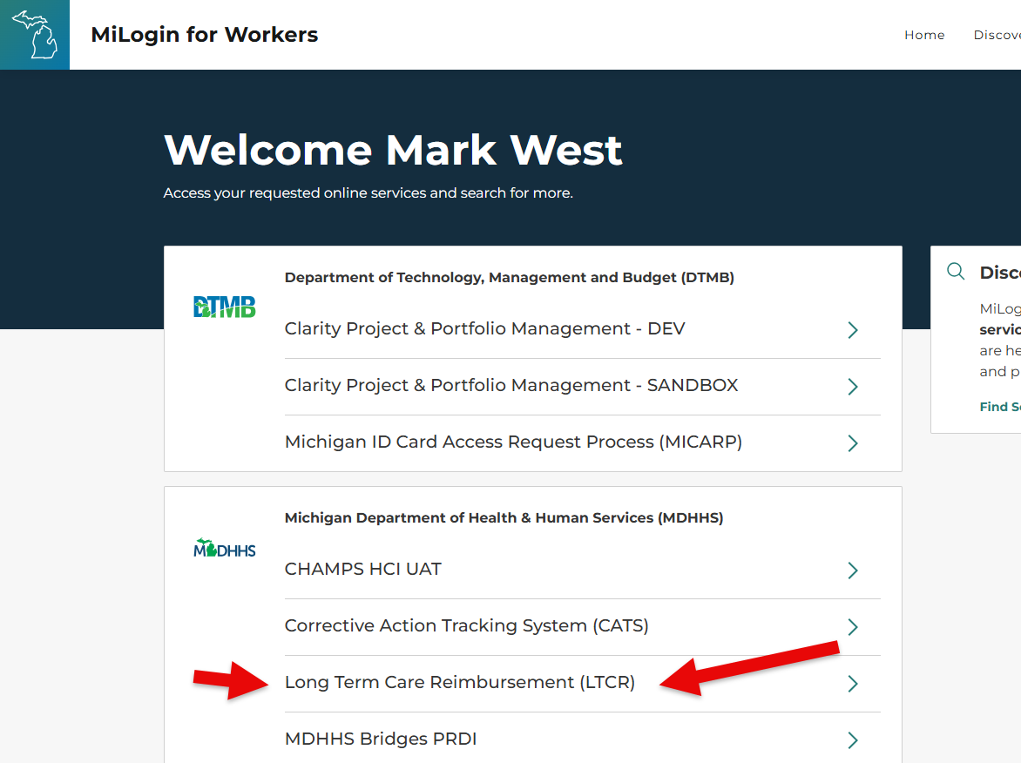
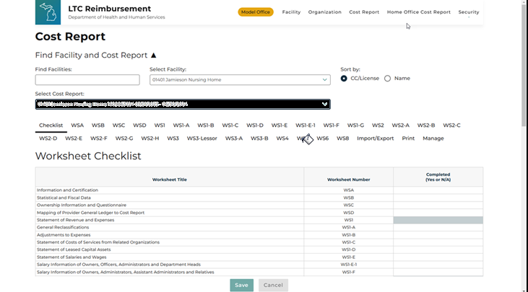
New online cost report
Actual screen shots from new on-line cost report

Slide 60

What's Next?
Audit Process
  Efforts continue to evaluate the process and implement changes to further decrease the audit timeline.
Communication
We will continue with quarterly presentations/meetings.
In months when presentations/meetings are not held, our team may release “Newsletters” sharing information

Slide 61

Any Questions Now?
If you think of questions later?
LTC Cost Reporting or Audit Questions:
DARS@michigan.gov
LTC Policy Questions:
walkerk32@michigan.gov
QAAP Assessment Questions:
schneiderm4@michigan.gov

Slide 62



Thank You
Notes:
In the coming days, you will receive:
A copy of this powerpoint presentation.
A link to the YouTube video of this recording
A compilation of Q/A from the chat.

